Slide 1
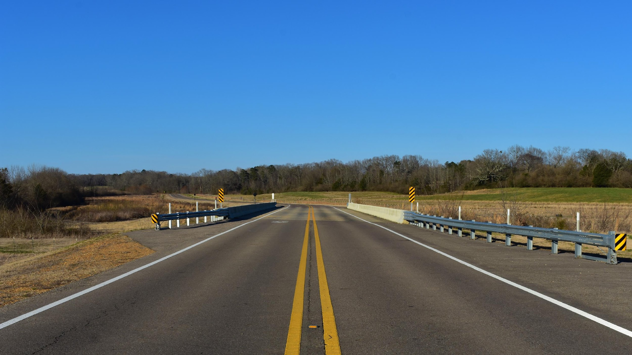
Collide-o-Scope
Ajaya Dahal, Walker Thames, Zachary Sahnger, William Clark, Joseph Westerfield
Notes:
I added this just because we needed something more on the title page, can be changed if doesn’t look good.
-Walker

Slide 2
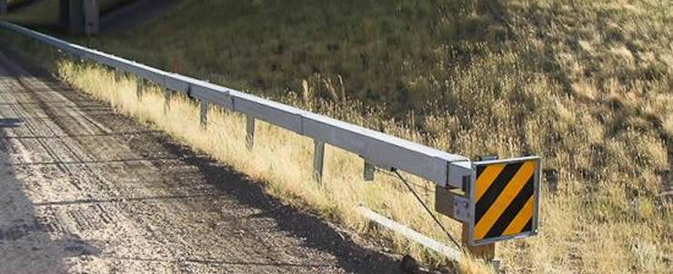
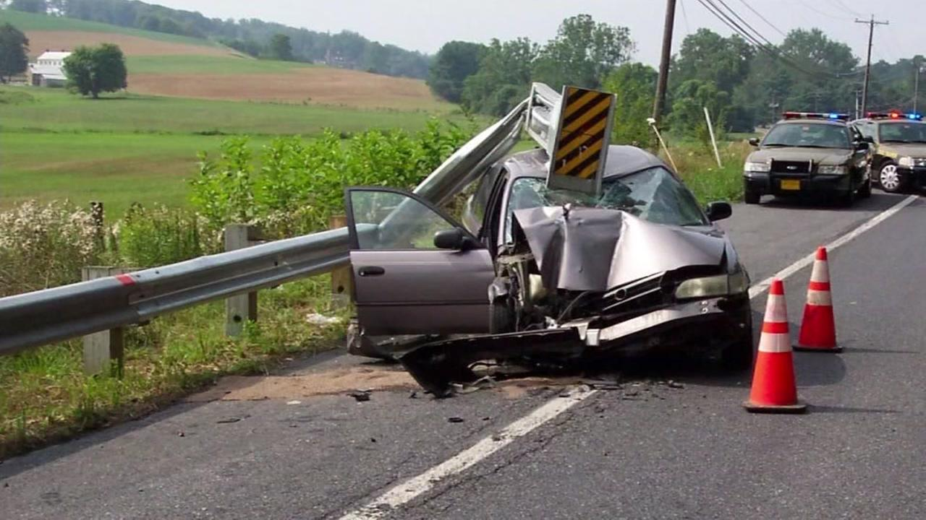
Problem
Terminal end sections (TES) of guardrails are everywhere, at least 4 required for nearly every bridge in the country.
The state of Alabama has installed over 9000 since 2018 [1]
Our sponsor, Atwood Fencing, has purchased over 3000 since 2018 [1]
These terminal ends are constantly being destroyed and replaced.
Many sections exist in rural areas, with DOT employees driving regularly over the entire state, inspecting for damage.
Fig. 1. A terminal end section of guardrail [2]
Fig. 2. A terminal end section destroyed by a car [3]
Notes:
Walker Thames

Slide 3
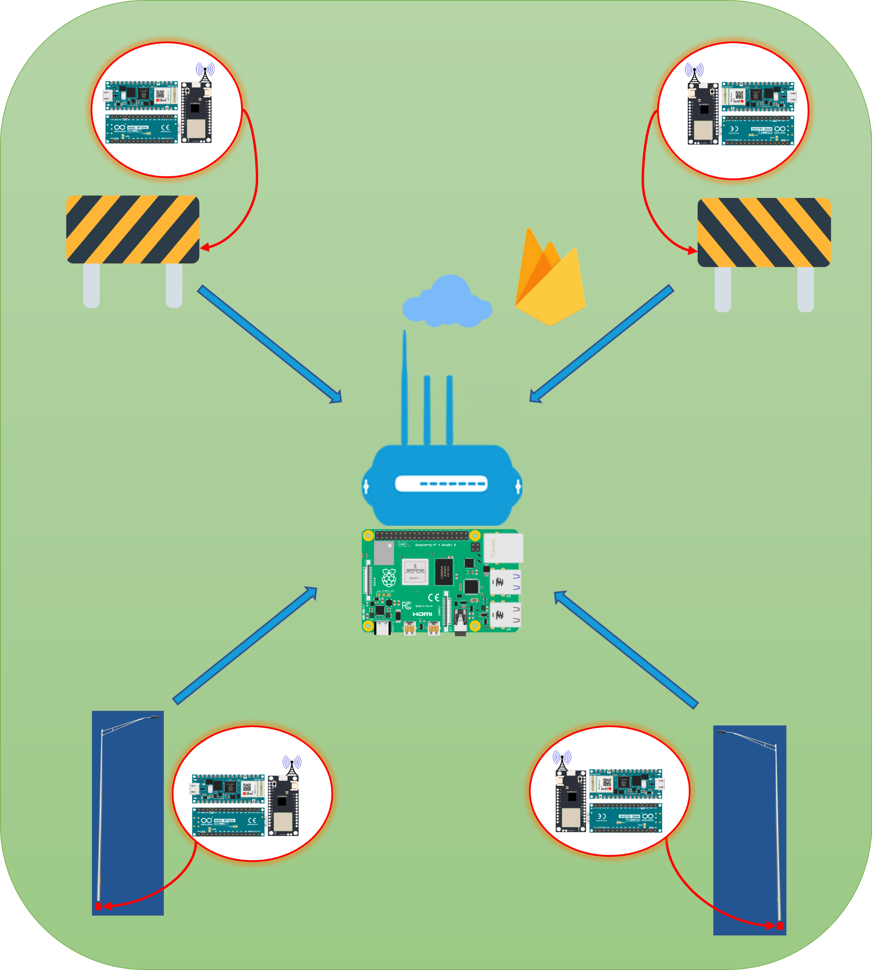

Solution
IOT using LoRaWAN Technology
End nodes are attached to guardrails, light post, etc.
Send the signal via LoRa to the gateway
Gateway uploads the data to cloud(firebase)
Users gets notification via Flutter apps(web app, android, and ios).
Notes:
AJ

Slide 4


Customers
Companies involved in the maintenance/construction of roads, highways, and bridges
State Departments of Transportation (DOTs)
United States Department of Transportation
DOT contractors
First Responders
Notes:
Anyone involved in guardrails could benefit
Departments of transportation could know when there is damage
DOT contractors who hire/maintain rails know when their needed (ie. Atwood)
First responders (police, ambulances, etc.) to know when there may have been a wreck

Slide 5

Outreach
Create a website and social media following for advertising
Reach out to state DOTs and contractors either with cold calling or through connections formed with previous clients
Communicate the necessity of our product with data and analysis
Notes:
Joey

Slide 6
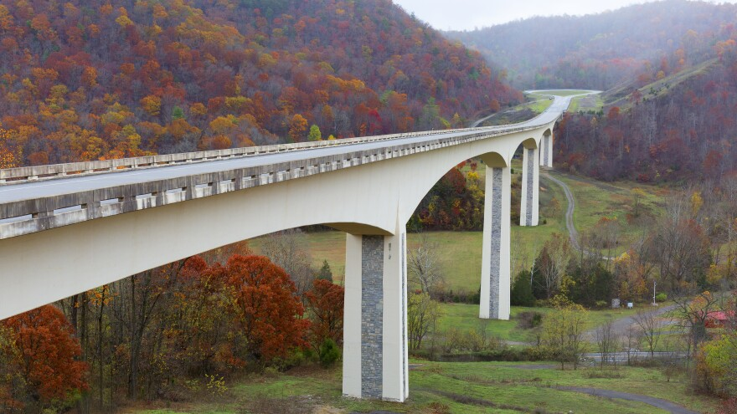
Competition
While patents for a similar concept do exist, they are either expired [4], or pending [5].
The idea of IOT has been applied to the road system before, but in vastly different ways, such as the Virginia Smart Roads [6]
A section of a smart road in Virginia [7]
Notes:
TODO: proofread, check references format. Determine why previous patent’s didn’t go anywhere. Discuss how no similar products currently exist. Talk about Smart roads and how it differs from what we’re doing. (sensing pavement conditions, traffic volume, etc)

Slide 7
Works Cited
[1] N. Wise, Sensor Project - Follow Up, 20-Jan-2022.
[2] Highway-guardrail.com, 2022. https://www.highway-guardrail.com/img/type-b-guardrail-terminal-ends.jpg (accessed Jan. 26, 2022).
‌[3]Go.com, 2022. https://cdns.abclocal.go.com/content/kgo/images/cms/1502726_1280x720.jpg (accessed Jan. 26, 2022).
‌[4] Highway Crash Barrier Monitoring System, by Jeffrey A. Geary, David A. Smith. (2003 March 25) US 6539175 B1 [online]. Available: https://patents.google.com/patent/US6539175B1/en
[5] Highway guardrail impact positioning and alarming system and method based on Internet of things technology, by 王俊骅, et al. (2011 May 18) CN102063780A [online] Available: https://patents.google.com/patent/CN102063780A/en
[6] “Facilities,” Virginia Smart Roads: Highway Section | Virginia Tech Transportation Institute. [Online]. Available: https://www.vtti.vt.edu/facilities/highway-section.html. [Accessed: 24-Jan-2022].
[7]“Smarter ‘Smart Road’ Paves the Way for Driverless Vehicles,” WVTF, Nov. 16, 2017. https://www.wvtf.org/news/2017-11-16/smarter-smart-road-paves-the-way-for-driverless-vehicles (accessed Jan. 26, 2022).

